Slide 1
Salary Prediction based on Years of Experience
Presented By:
K.Swency
Dataset: YearsExperience and Salary records.
Insights: Exploratory Data Analysis (EDA) revealed a positive relationship between YearsExperience and Salary records

Slide 2
Objective
The primary goal of this project is to predict salaries based on the number of years of experience. The objective is to understand the relationship between years of experience and salaries, build a predictive model using linear regression, and provide valuable insights for human resource management and salary negotiations.

Slide 3
Exploratory Data Analysis (EDA):
Scatter Plot: Visualized the relationship between YearsExperience and Salary. Identified patterns and trends in the data.
Linear Regression Model: Utilized a simple linear regression model to quantify the relationship between years of experience and salaries.
Model Evaluation:Evaluated the model performance using Mean Squared Error (MSE) and R-squared metrics.

Slide 4
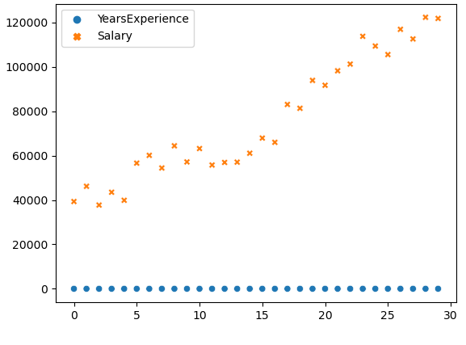
Insights and Findings:
The scatter plot of Salary vs YearsExperience shows a generally positive linear relationship. As years of experience increase, salaries tend to rise.

Slide 5
Salary (Intercept):
The intercept provides an estimate of the starting salary when years of experience are zero, contributing to the baseline of the linear model.
Coefficient Interpretation:
The coefficient of the model represents the average increase in salary for each additional year of experience. Understanding this value is crucial for predicting salary changes.

Slide 6
Business Impact
Informed Salary Negotiations:
The model can provide valuable insights for individuals negotiating salaries based on their years of experience.
Human Resource Management:
Human resource teams can leverage the model to make data-driven decisions regarding salary structures, promotions, and workforce planning.
Employee Retention:
Understanding the impact of years of experience on salaries can contribute to strategies for employee retention and career development.

Slide 7
Future Considerations:
Additional Factors:
Consider incorporating additional factors such as education level, industry, or location to create a more comprehensive salary prediction model.
Continuous Model Improvement:
Regularly update and refine the model with new data to ensure its accuracy and relevance over time.
Collaboration with Stakeholders:
Collaborate with human resource professionals and other stakeholders to incorporate domain-specific insights into the model.

Slide 8
Conclusion
In conclusion, this project provides a foundation for predicting salaries based on years of experience. The insights gained can be instrumental in making informed decisions related to human resource management and salary negotiations, contributing to overall organizational success. Continuous improvement and collaboration with stakeholders are key to maximizing the impact of the model.

